Slide 1
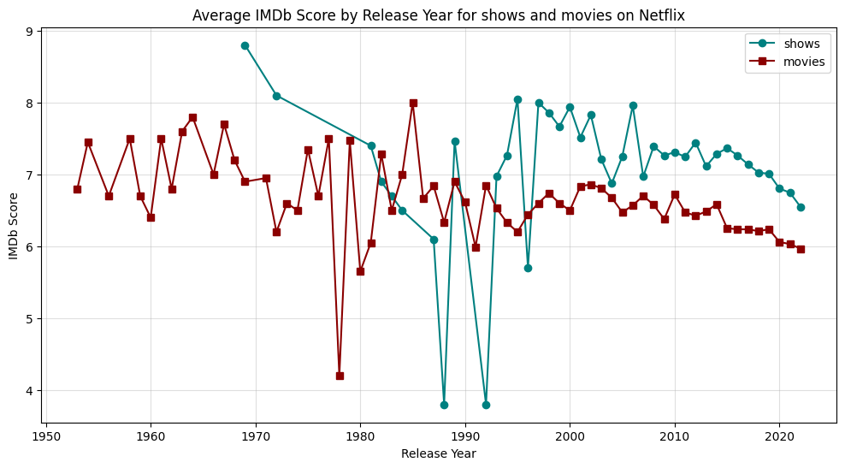
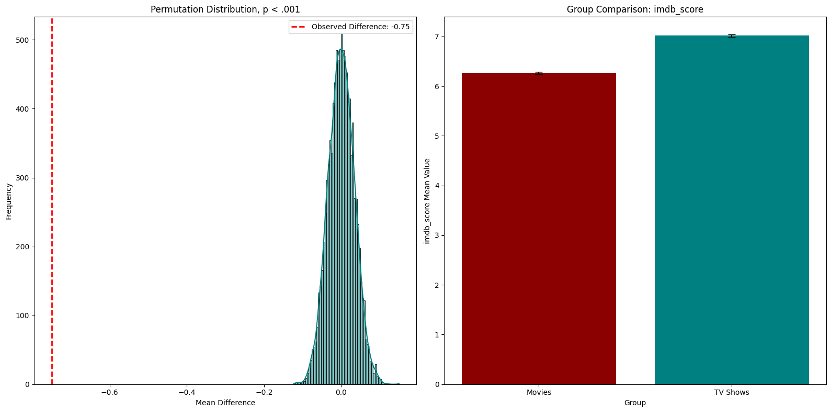
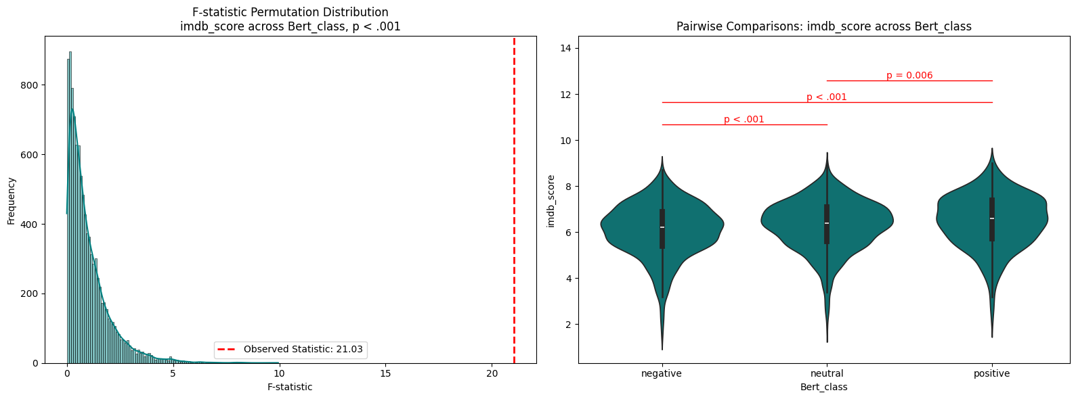
Netflix Analysis: A Statistical View on Movies and Shows
Group 23: Daniel Schipfer • Monika Windhager • Kaniz Fatema • Abdelrahman Ali
TU Graz University - Austria
Research Questions
Do Movies (a) or Shows (b) on Netflix with an older release year have a better average IMDb ratings?
Do Movies (a) or Shows (b) on Netflix with a more positive description get better IMDb ratings?**
Do Movies or Shows on Netflix get better IMDb ratings (a) or more IMDb votes (b) and do they differ in runtime (c)?
Did the runtime of Movies (a) or Shows (b) that are on Netflix change over the years?
Data and Methods
The dataset used contains information about Netflix’s content as “Titles”, “Types”, “Release Year”, “Runtime”, “Votes”, and “Scores”.
Methods Used include:
1. Trend Analysis with Line Plot.
2. Correlation Analysis with Scatter Plot.
3. Statistical T-Test with Box Plot.
Results

